Slide 1

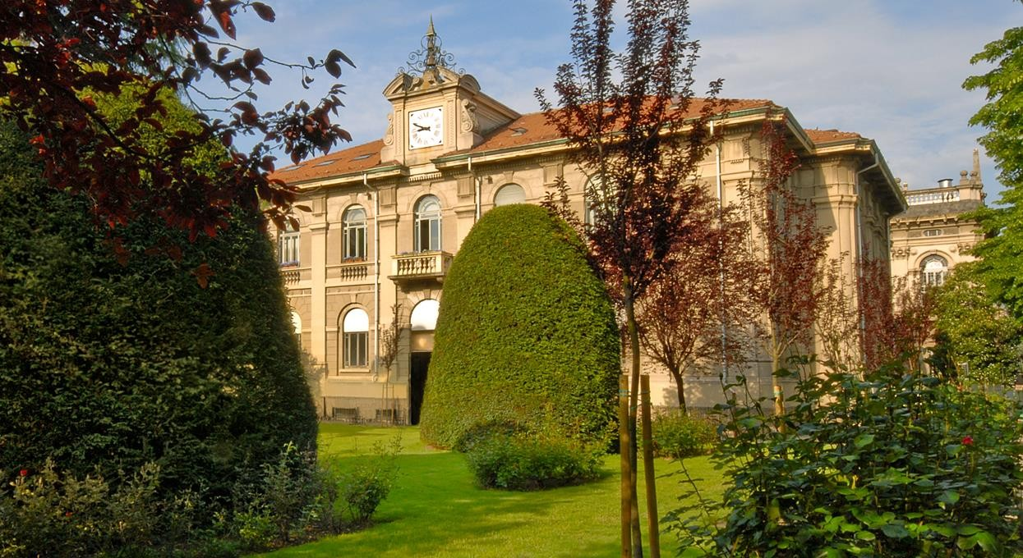

Earth Observation
Assessing Burn Severity Indexes for
Fire Mapping
using Mulstispectral Satellite Imagery
Lorenzo Carlassara 10601118
2022/2023

Slide 2

Wildfire GHGs emissions
https://www.researchgate.net/figure/Comparison-of-the-spectral-response-of-healthy-vegetation-and-burned-areas-Source-USDA_fig4_359705541

Slide 3
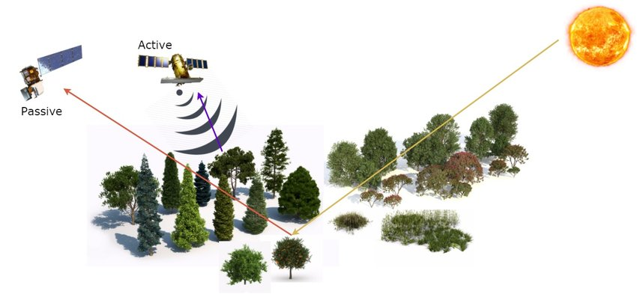
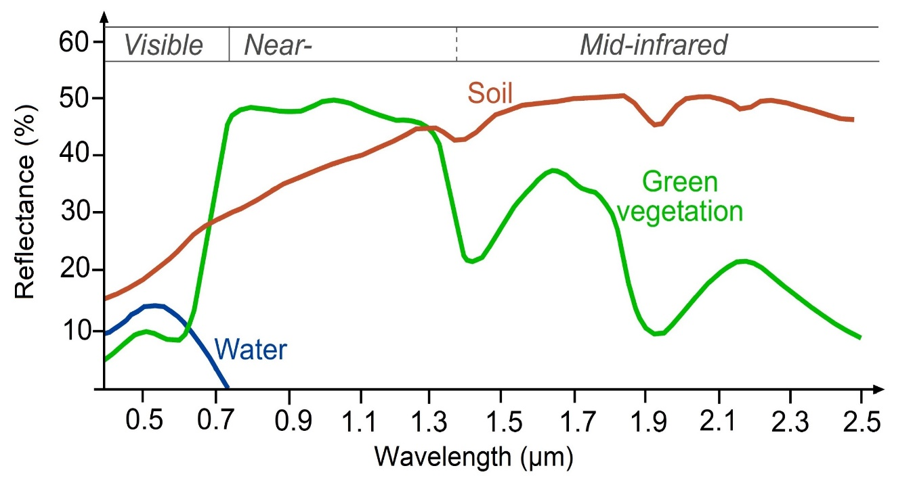
Multispectral Satellite
External
Radiation
Source
Spectral signature
https://www.researchgate.net/figure/Remote-sensing-from-satellite-active-and-passive-sensors_fig1_318470938
https://www.researchgate.net/figure/Typical-spectral-signatures-of-specic-land-cover-types-in-the-VIS-and-IR-region-of-the_fig2_326405082

Slide 4
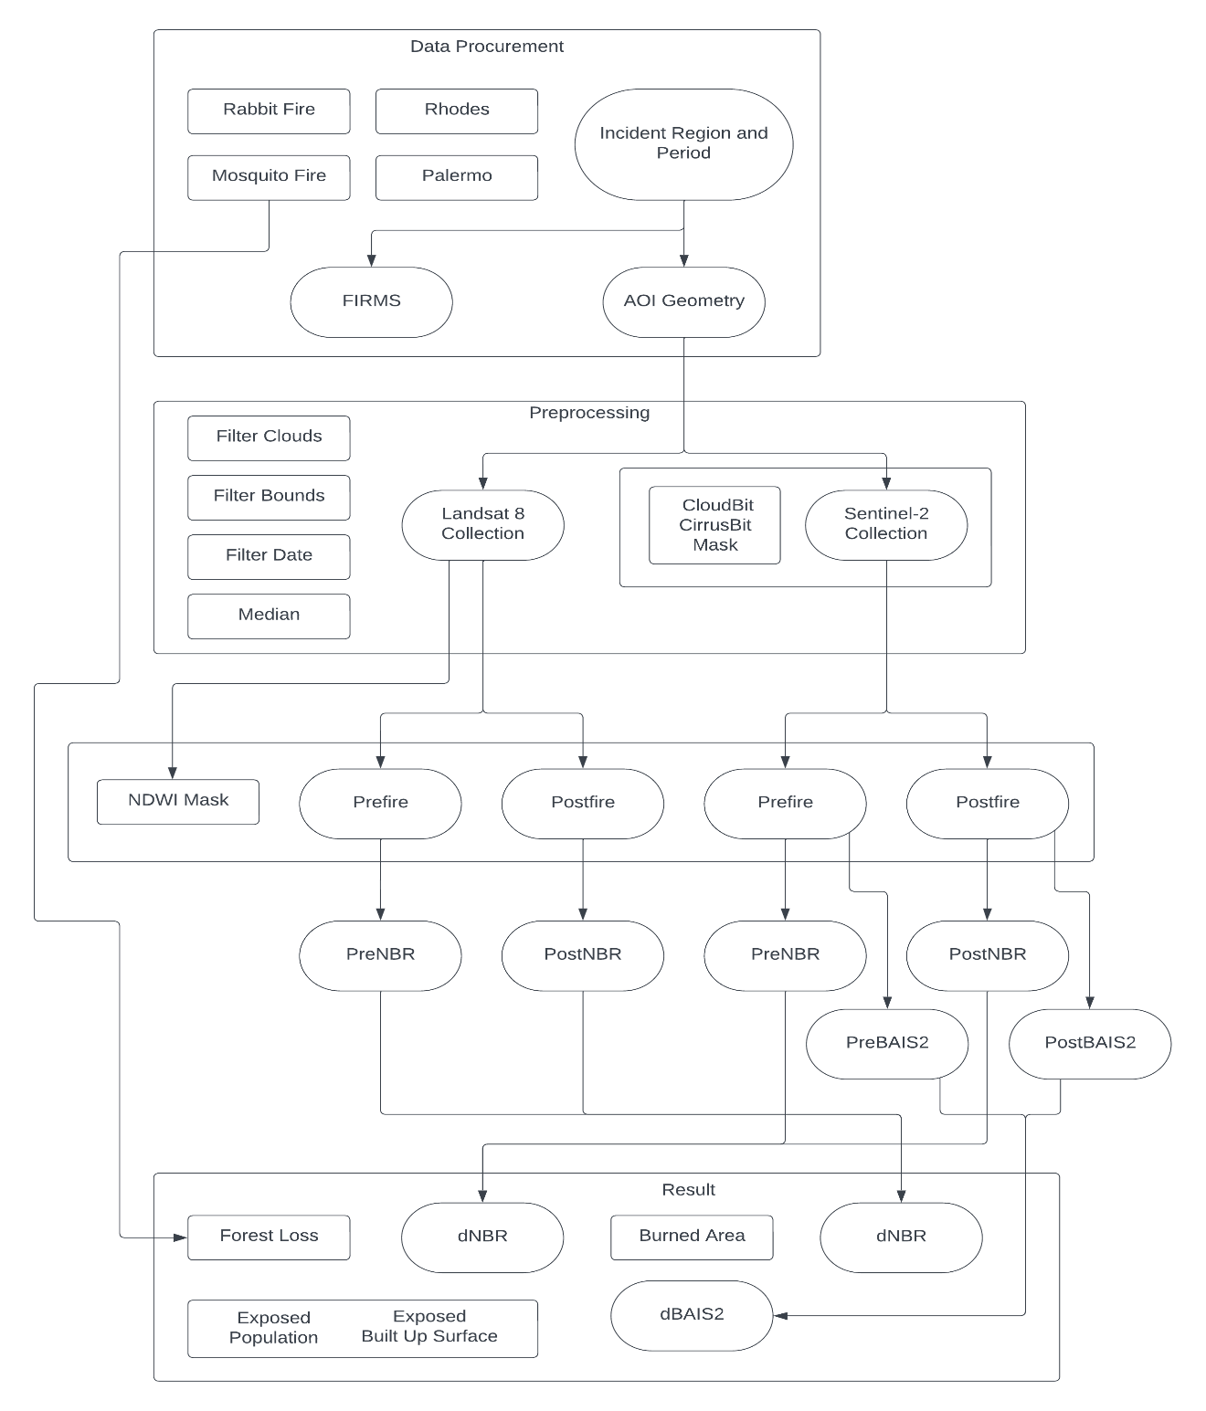
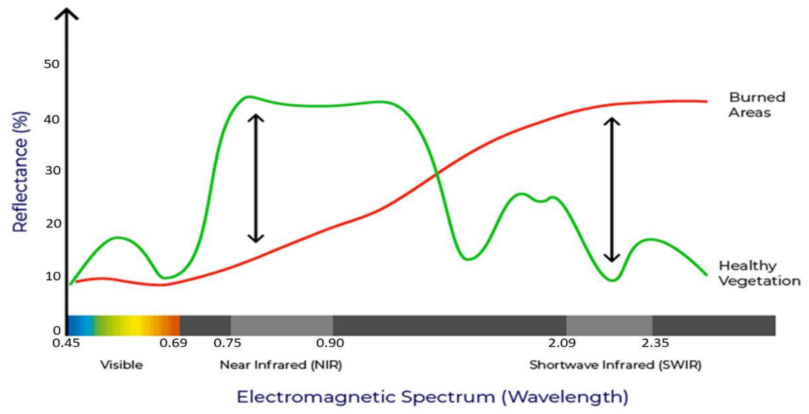
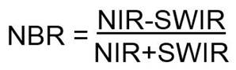
Workflow
Burned Areas vs Healty Vegetation
Spectral Signature
Normalize Burn Ratio

Slide 5
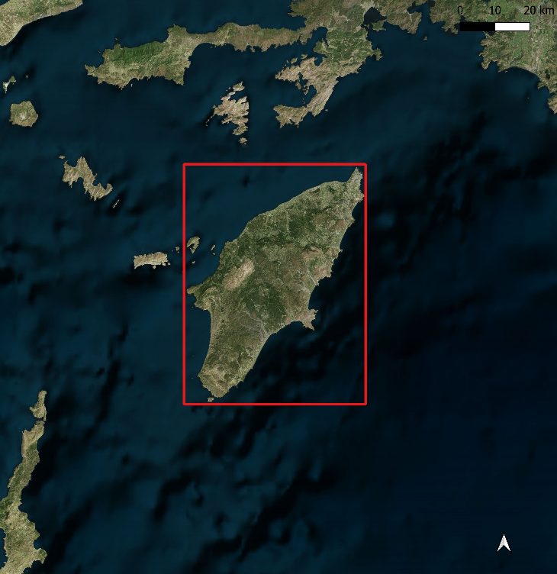
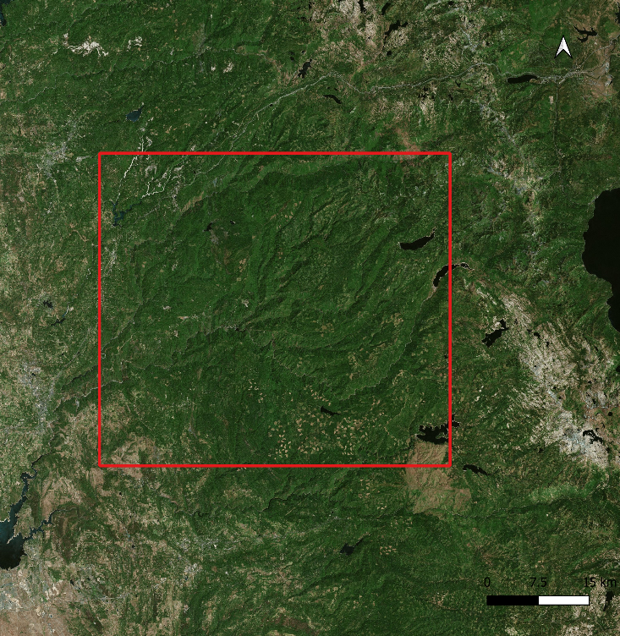
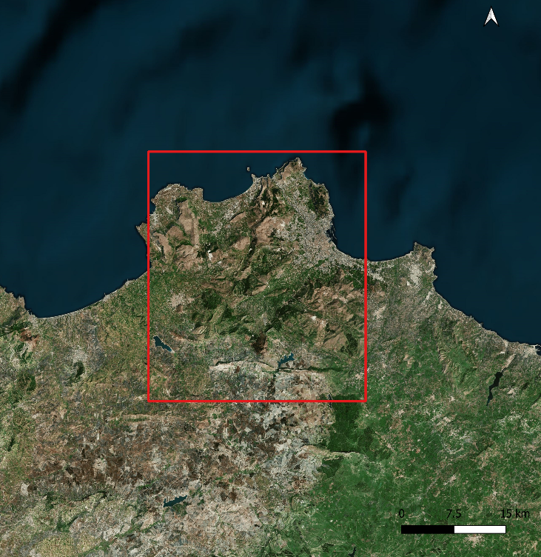
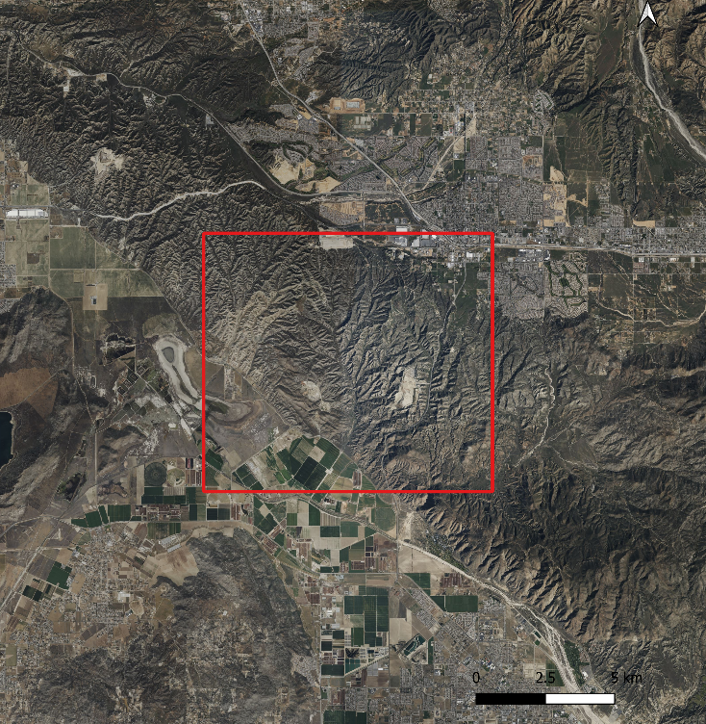
Four Wildfire Regions
Rhodes wildfires (Dodecanese, Greece)
18th July 2023 - 30th July 2023
Palermo wildfires (Sicily, Italy)
21st July 2023 - 9th August 2023
Mosquito Fire, Placer county (California, USA)
1st September 2022 - 20th September 2022
Rabbit Fire, Riverside county (California, USA)
14th July 2023 - 22nd July 2023
Rhodes, GR
Mosquito Fire, CAL
Palermo, IT
Rabbit Fire, CAL
CRS: WGS 84 / Pseudo-Mercator

Slide 6
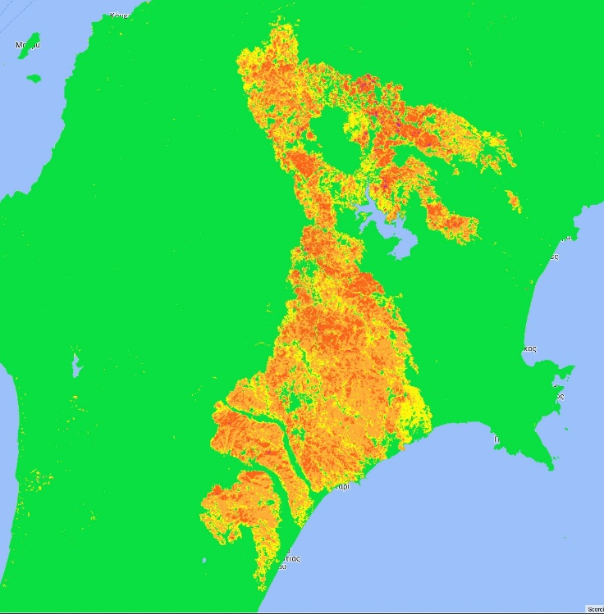
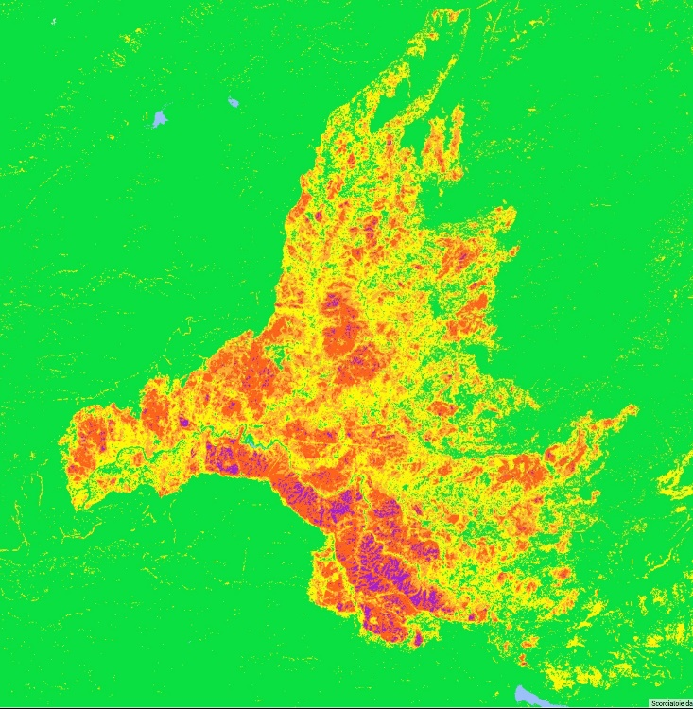
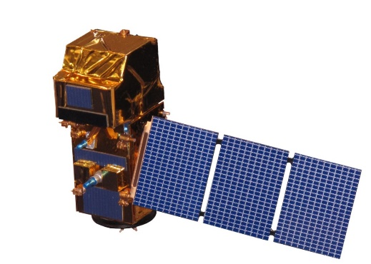
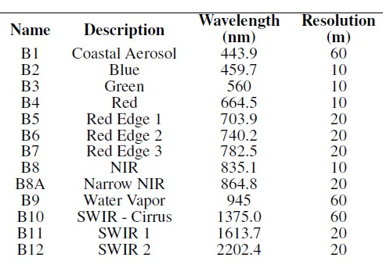
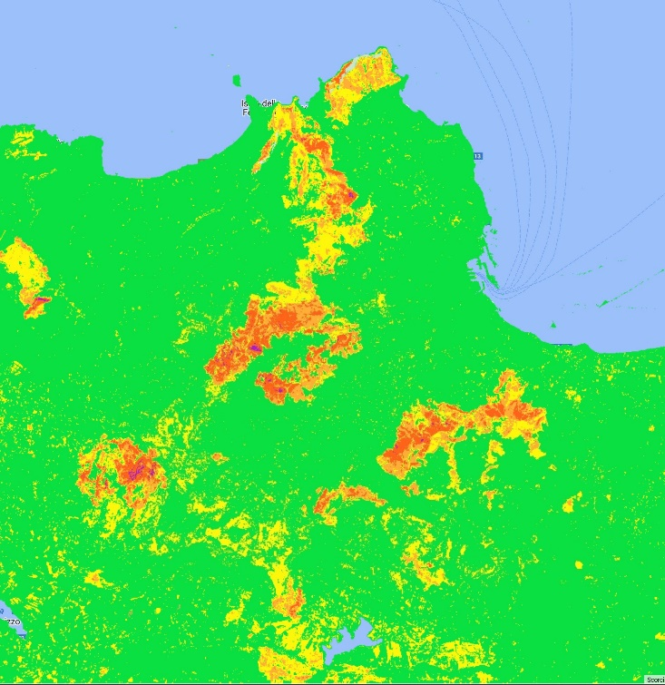
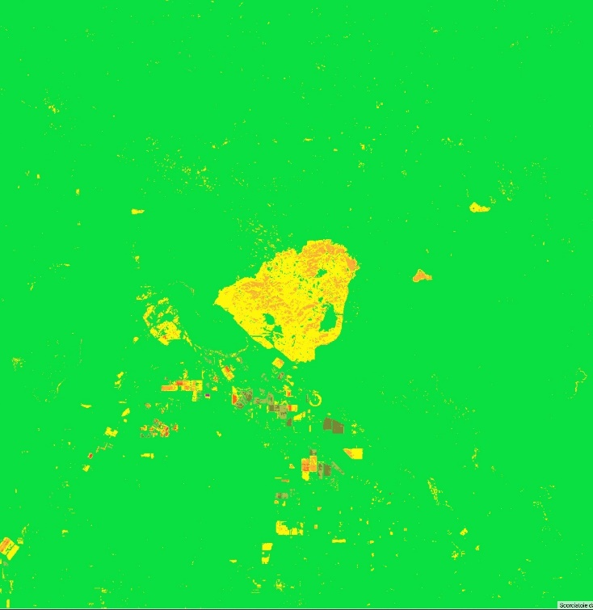
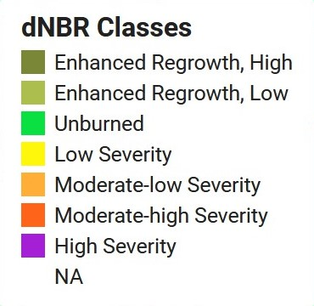
Sentinel-2
https://sentinels.copernicus.eu/web/sentinel/user-guides/sentinel-2-msi/resolutions/spatial

Slide 7
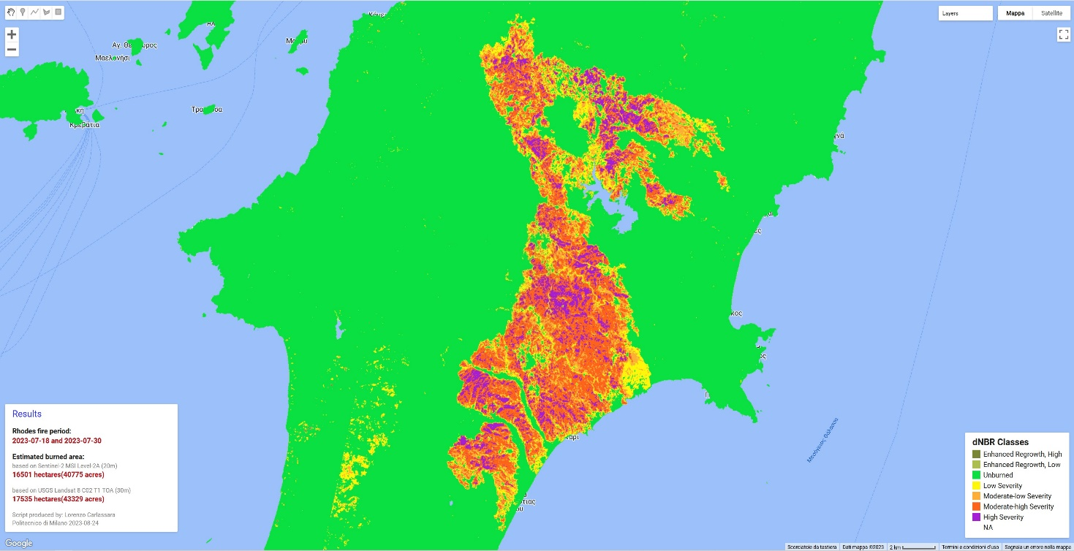
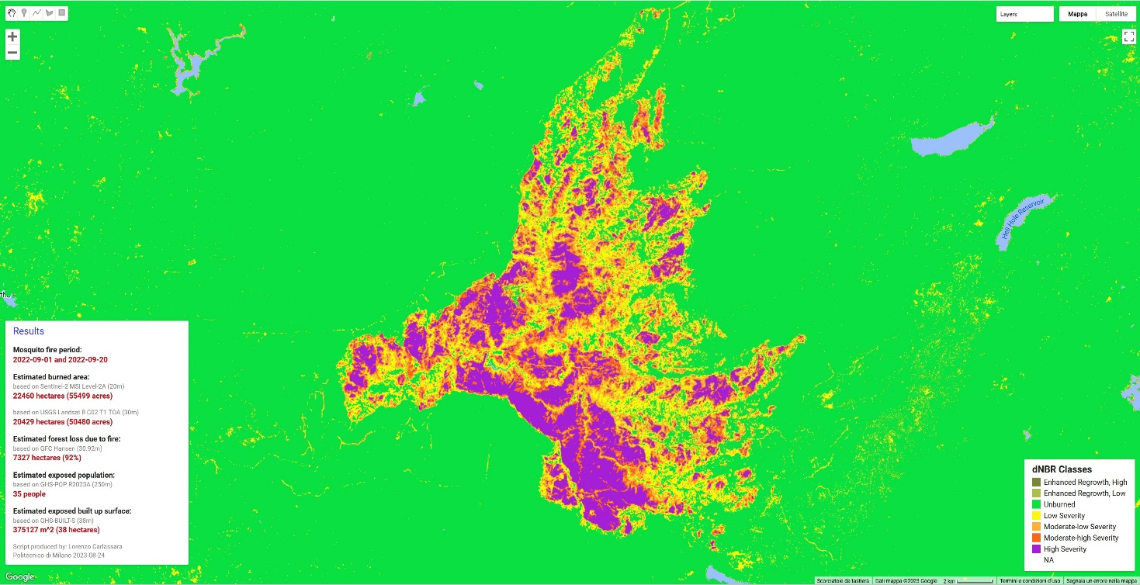
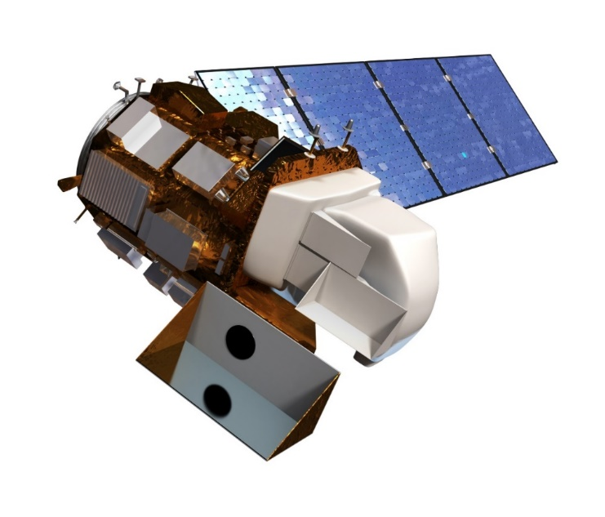
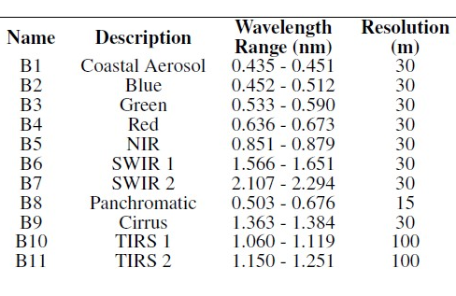
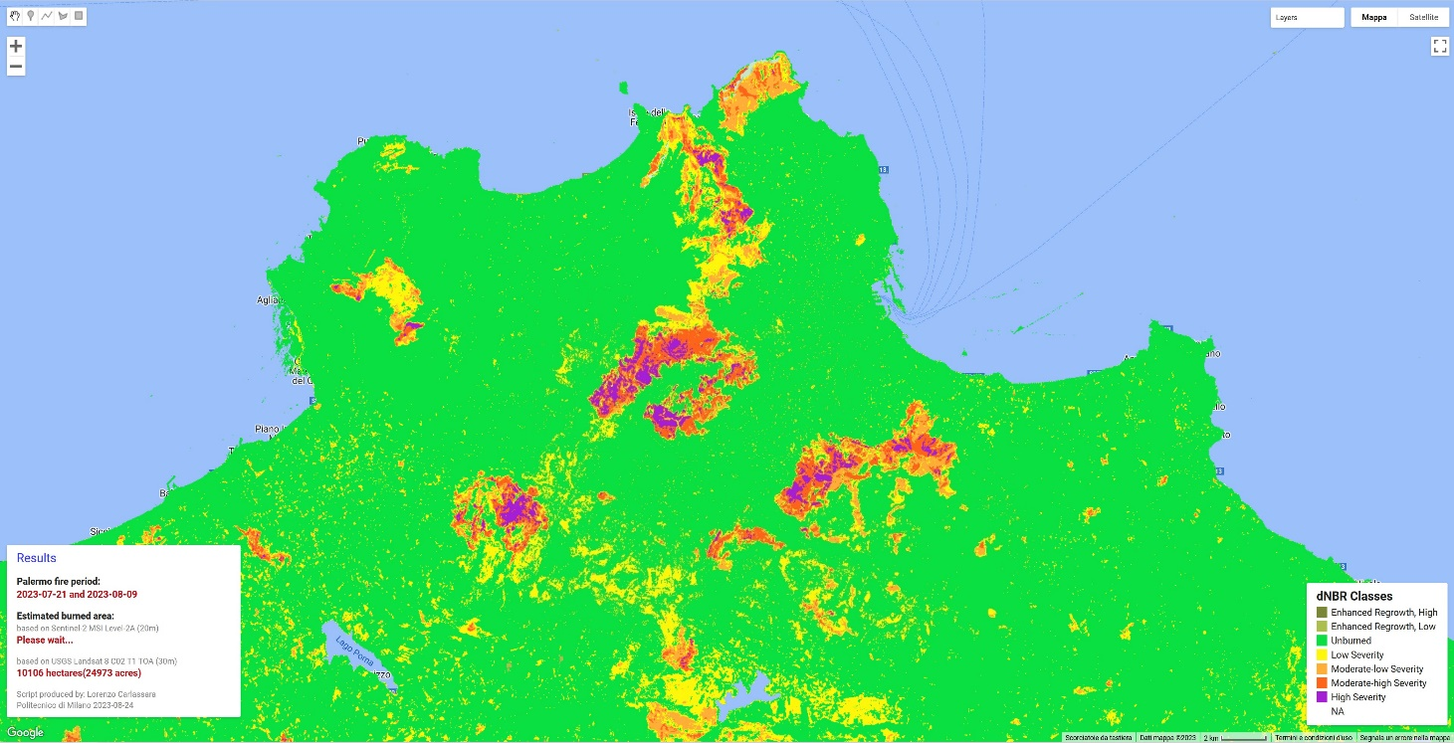
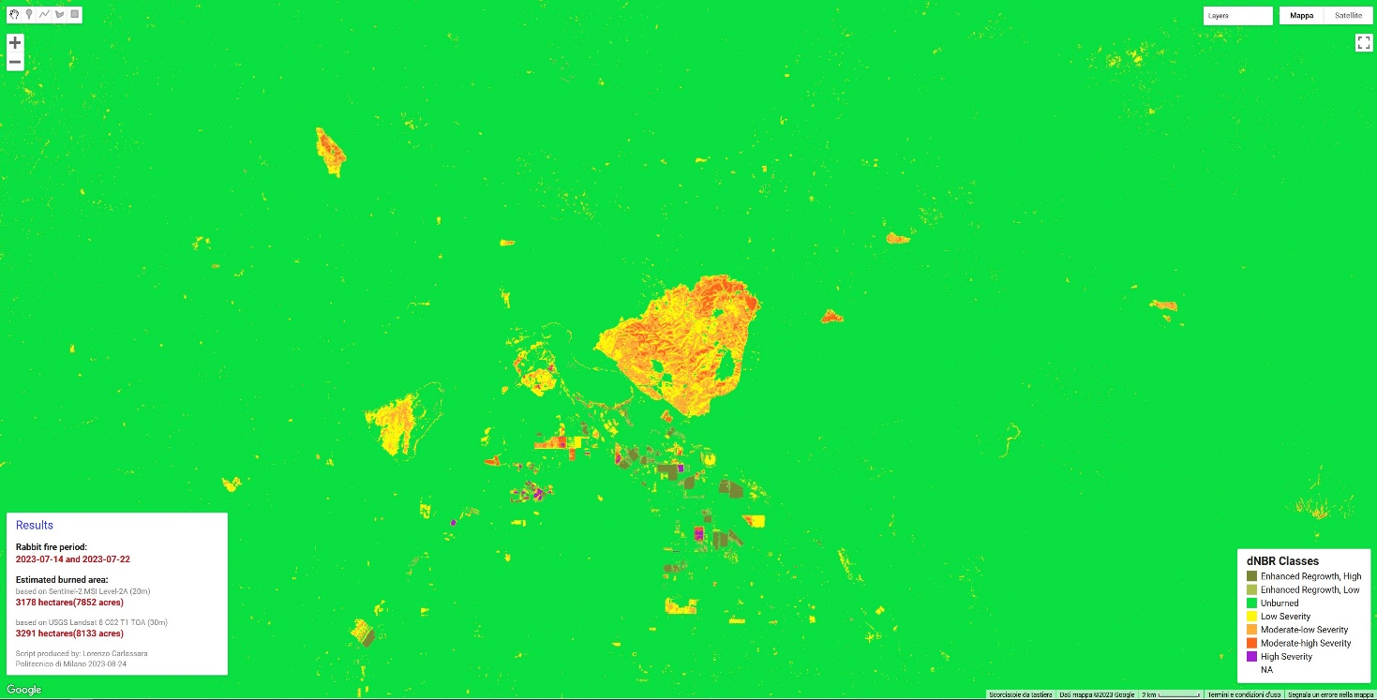
Landsat 8
https://landsat.gsfc.nasa.gov/satellites/landsat-8/
https://www.usgs.gov/media/images/landsat-8

Slide 8
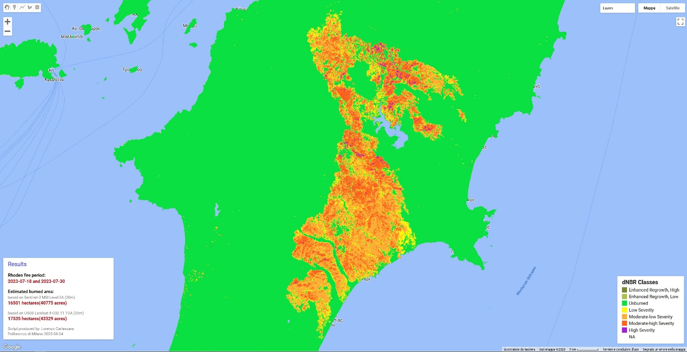
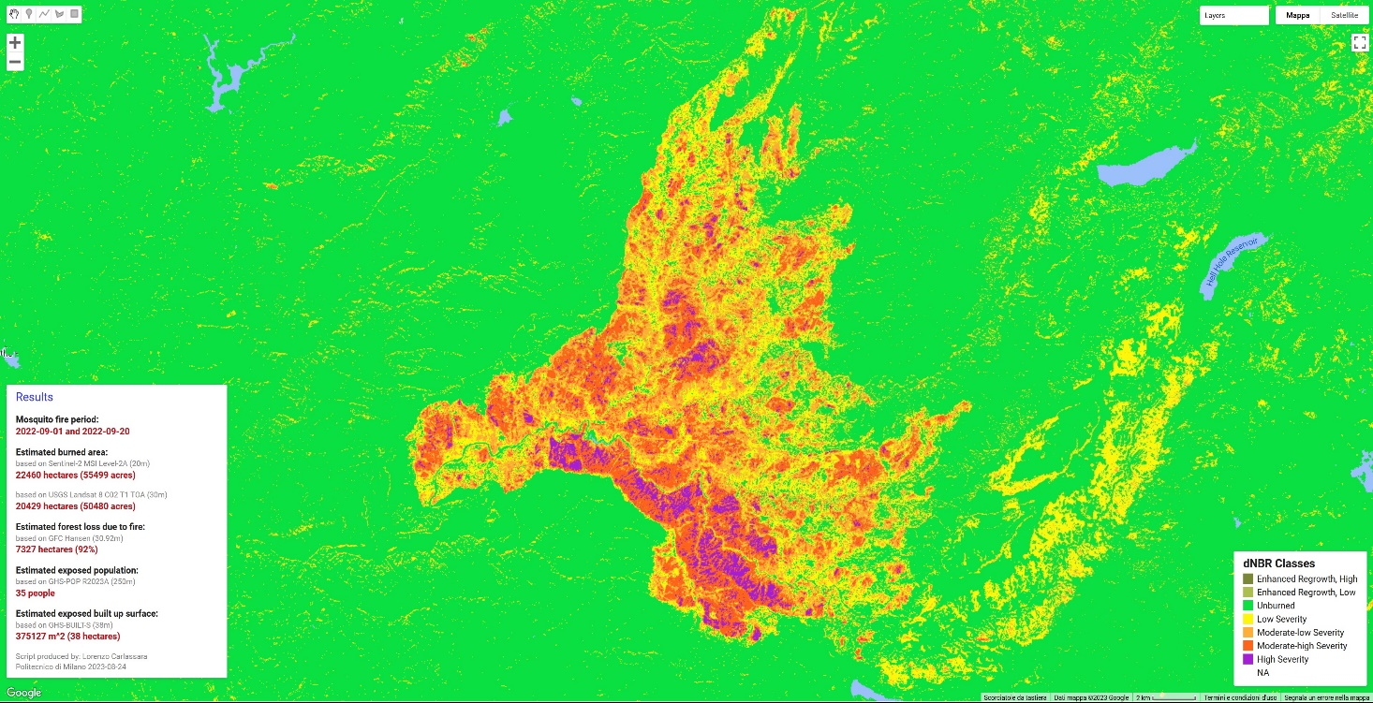
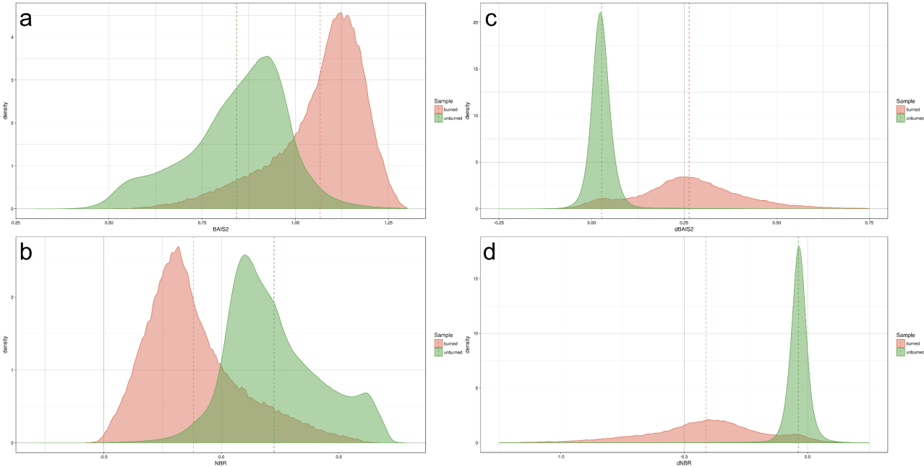
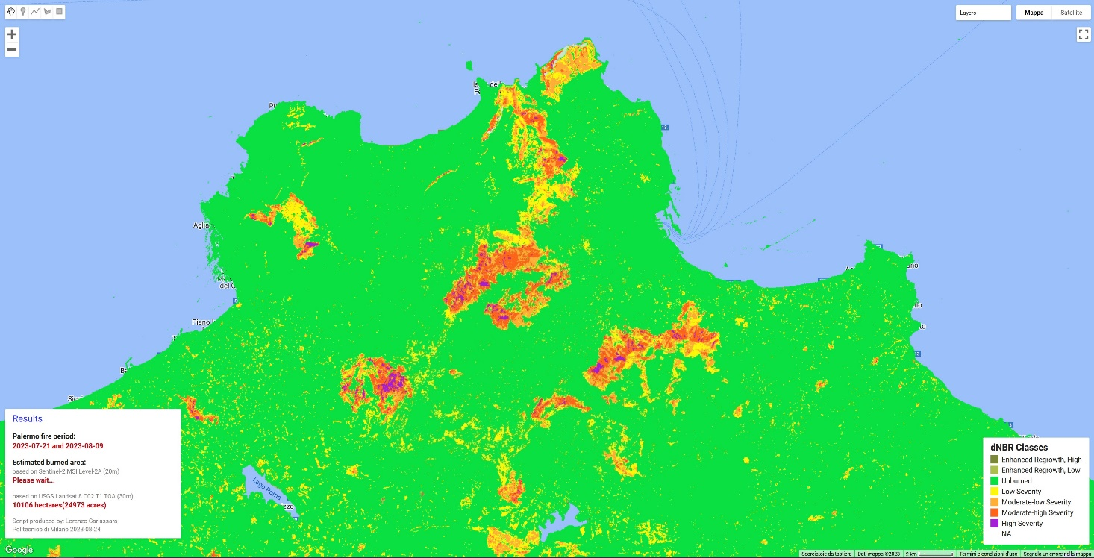
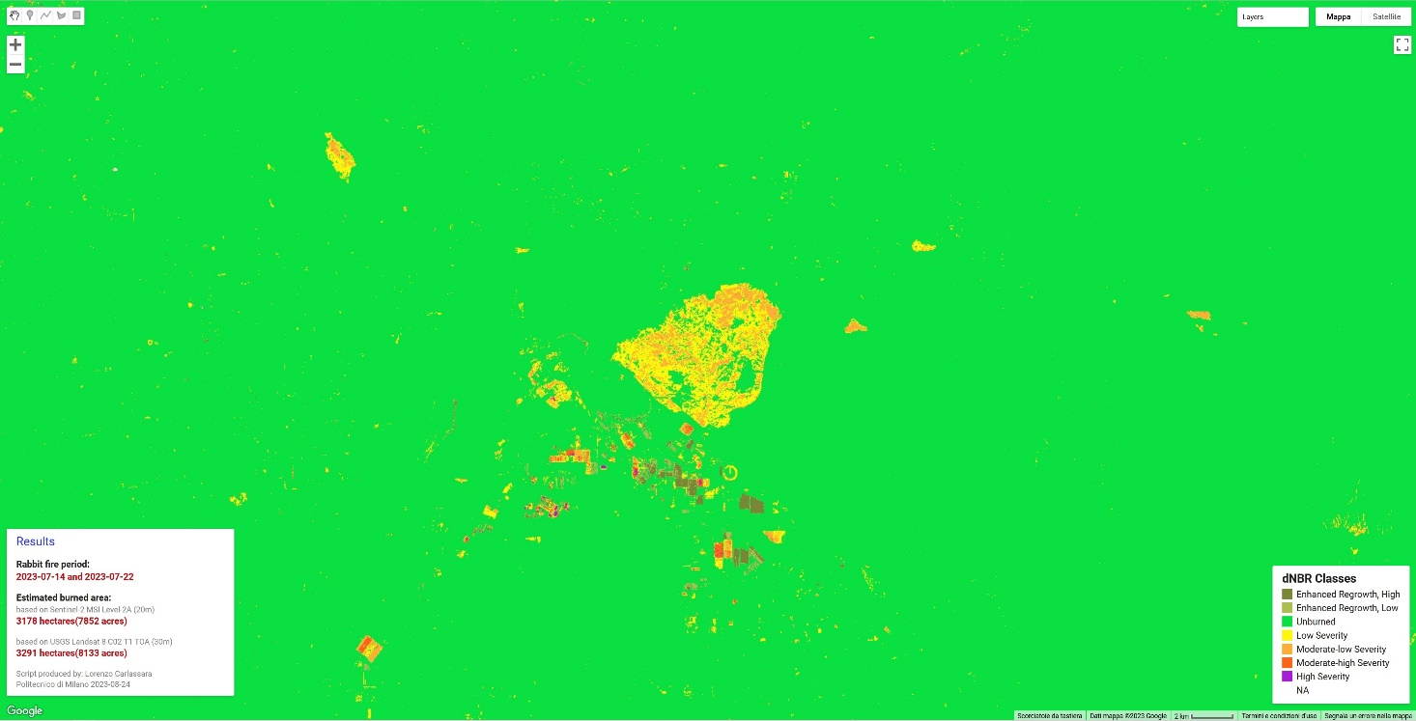
dBAIS2
dNBR

Slide 9
Burned Area Detector

Slide 10
Burned Area Detector

Slide 11
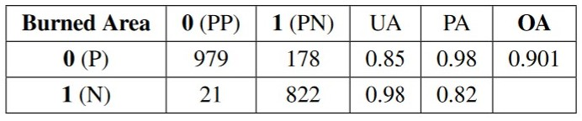
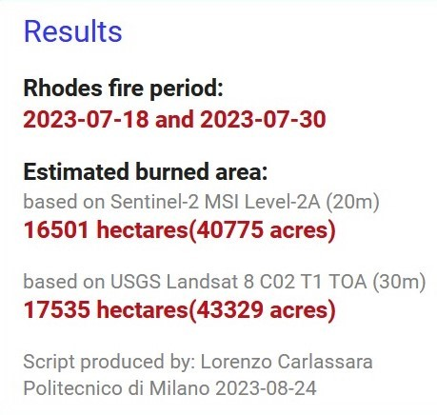
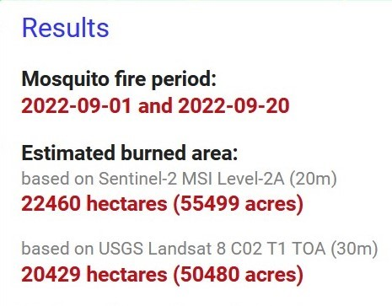
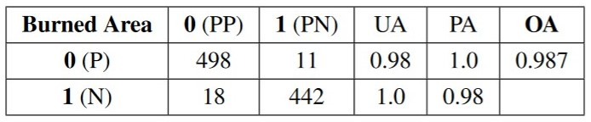
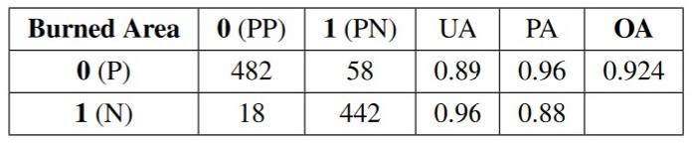
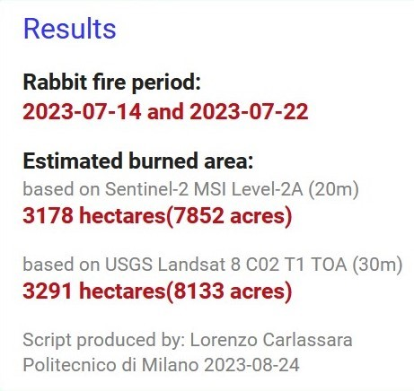
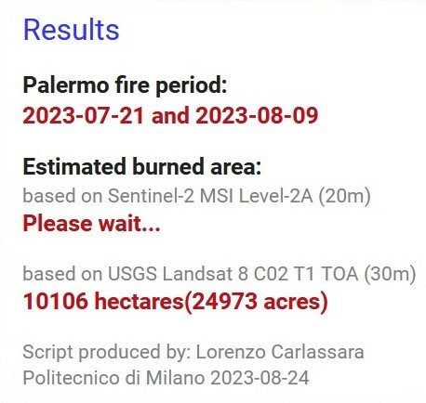
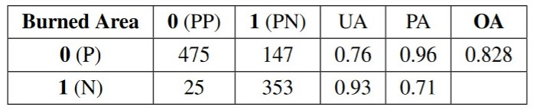
Confusion Matrices

Slide 12
Thanks for your attention!
lorenzo.carlassara@mail.polimi.it
Geoinformatics Engineering
All materials in this presentation are from the public literature and internet. Use herein of copyrighted material is purely for academic purposes.

